Slide 1
Arrested Development:
Impact of Social Media on Children’s Mental Health
and Spiritual Formation
Lisa Beardsley-Hardy, PhD, MPH
Director of Education
General Conference of Seventh-day Adventists

Slide 2
Dr. Google: Good or Bad?
It depends!
Provides quick access to many sources of information
But use of Dr. Google online symptom checkers not reliable for medical diagnosis and treatment (https://onlinelibrary.wiley.com/doi/full/10.5694/mja2.50600)
Requires digital literacy and content knowledge to assess information
May provide age-inappropriate information, images, videos, and music and access to children and the vulnerable by predators, scammers, bullies
Cause and effect not clear
This Photo by Unknown Author is licensed under CC BY-NC-ND

Slide 3
A Heavy Suitcase
“And so seated next to my father in the train compartment, I suddenly asked, "Father, what is sexsin?" He turned to look at me, as he always did when answering a question, but to my surprise he said nothing. At last he stood up, lifted his traveling case off the floor and set it on the floor. Will you carry it off the train, Corrie?" he said. I stood up and tugged at it. It was crammed with the watches and spare parts he had purchased that morning. It's too heavy," I said. Yes," he said, "and it would be a pretty poor father who would ask his little girl to carry such a load. It's the same way, Corrie, with knowledge. Some knowledge is too heavy for children. When you are older and stronger, you can bear it. For now you must trust me to carry it for you.”
― Corrie Ten Boom, The Hiding Place: The Triumphant True Story of Corrie Ten Boom

Slide 4
Examples of Age-Restricted Activities
Drive a moped, car, commercial vehicle, bus or airplane
Buy certain products (cigarettes, alcohol, firearms)
Gamble
Vote in elections
Serve in the military
Give legal consent for certain activities

Slide 5
Relationship of Time on Task

Slide 6
Risks of Increased Screen Time on Devices
inconsistency in eating and exercise habits (Morin, 2020)
stunting in development of children’s imagination, communication skills and socialization (Morin, 2020)
behavioral and educational challenges in older children
creativity
interaction with peers and adults

Slide 7
Screen Time Decreases Attention Span
Microsoft found since 2000, the year the mobile revolution surged, attention span dropped from 12 seconds to 8 seconds.
Goldfish are able to focus for 9 seconds.
(Mayo Clinic for Tween and Teen Health)

Slide 8
Body Image
Reducing social media significantly improves body image in teens and young adults (Thai, et. al, 2023).
This Photo by Unknown Author is licensed under CC BY-SA
https://www.apa.org/news/press/releases/2023/02/social-media-body-image

Slide 9
Time With Parents Is Correlated With Academic Achievement
Cognitive Genesis, Kido et. al.

Slide 10
The Shema Yisrael (Deut. 6:4-5 NIV)
“Hear, O Israel: The Lord our God, the Lord is one. Love the Lord your God with all your heart and with all your soul and with all your strength.”

Slide 11
Child Development and the Shema Yisrael
”These commandments that I give you today are to be on your hearts. Impress them on your children. Talk about them when you sit at home and when you walk along the road, when you lie down and when you get up. Tie them as symbols on your hands and bind them on your foreheads. Write them on the doorframes of your houses and on your gates.” (Deut. 6:6-9, NIV)

Slide 12
Relationships
The Word of God and the Holy Spirit has power to birth spiritual life and regeneration (the doctrine of regeneration) [Gen. 8-9, Rev. 21-22, 2 Tim 3:15-17, 2 Peter 1:19-21, Matt. 4:4, 1 Thes 2:13, John 17:17].
Creation [Gen. 1-2]
De-creation (”sin”) [Gen 3]
Re-creation and redemption [Rev. 19, 21]

Slide 13
Teacher Manages Time to Educate for Eternity
Structure time through curricular content and learning activities
Allocate time to regenerative activities (prayer, Bible study and reflection, learning from the Book of Nature)
Model time management
Incorporate the Sabbath in educating for eternity, starting with preparing for the Sabbath on Friday

Slide 14
Lessons of Good and Evil in Nature
“So far as possible, let the child from his earliest years be placed where this wonderful lesson book shall be open before him. Let him behold the glorious scenes painted by the great Master Artist upon the shifting canvas of the heavens, let him become acquainted with the wonders of earth and sea, let him watch the unfolding mysteries of the changing seasons, and, in all His works, learn of the Creator.

Slide 15
Lessons of Good and Evil in Nature
“In no other way can the foundation of a true education be so firmly and surely laid. Yet even the child, as he comes in contact with nature, will see cause for perplexity. He cannot but recognize the working of antagonistic forces. It is here that nature needs an interpreter. Looking upon the evil manifest even in the natural world, all have the same sorrowful lesson to learn—’An enemy hath done this.’ Matthew 13:28.” Education, pp. 100-101.

Slide 16
Specific Strategies
How do you structure time through curricular content and learning activities?
How do you allocate time to regenerative activities (prayer, Bible study and reflection, learning from the Book of Nature)?
How do you model time management?
How do you incorporate the Sabbath into educating for eternity, starting with preparing for the Sabbath on Friday?

Slide 17
Screen Time With Google, Twitter, Snapchat vs. Time with Parents and God

Slide 18
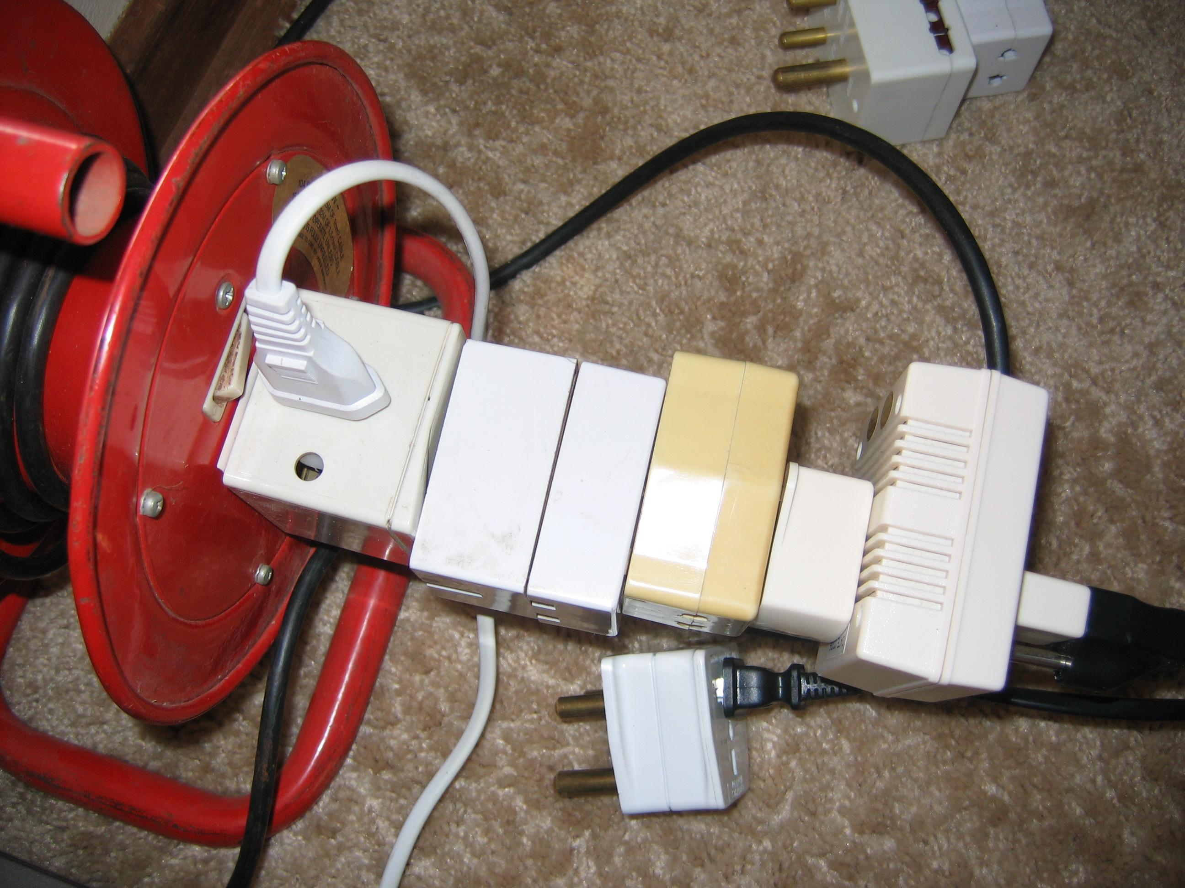
Redemptive development depends on being
connected to the Source of all power!!

